Slide 1

PHD THESIS PROJECT · PHD PROGRAM IN TRANSPORTATION SYSTEMS
Sensor-based Recyclables Collection Planning
Collection Planning
Planeamento de Recolha de Resíduos Recicláveis com Informação de Sensores
Esmaeil Keyvanloo Supervisor: Professor João Fonseca Bigotte University of Coimbra · Coimbra, July 28, 2026

Slide 2
PRESENTATION OUTLINE
What We Will Cover Today
WSmartRoute+ Project
Operational Database & Waste Generation Modelling
1
7
Background & Rationale
Waste generation Modelling & Regression Analysis
2
8
Research Gap
Deterministic Facility Location Model
3
9
Research Question & Objectives
WHY STOCHASTIC OPTIMISATION? From Fixed Demand to Robust Strategic Planning
4
10
Case Study: Rio Maior, Portugal
CONCLUSION
5
11
6
PROPOSED METHODOLOGY
1

Slide 3
1.WSmartRoute+ Project
FCT Research Project
GOAL Develop intelligent and sustainable municipal waste collection systems.
IoT
Sensors
Demand
Forecasting
Facility
Location
Vehicle
Routing
Decision
Support
→
→
→
→
MY PhD FOCUS
Strategic Infrastructure Planning
Waste Demand Modelling | Deterministic Facility Location | Stochastic Facility Location
My research contributes is limited the strategic planning level of the WSmartRoute.

Slide 4
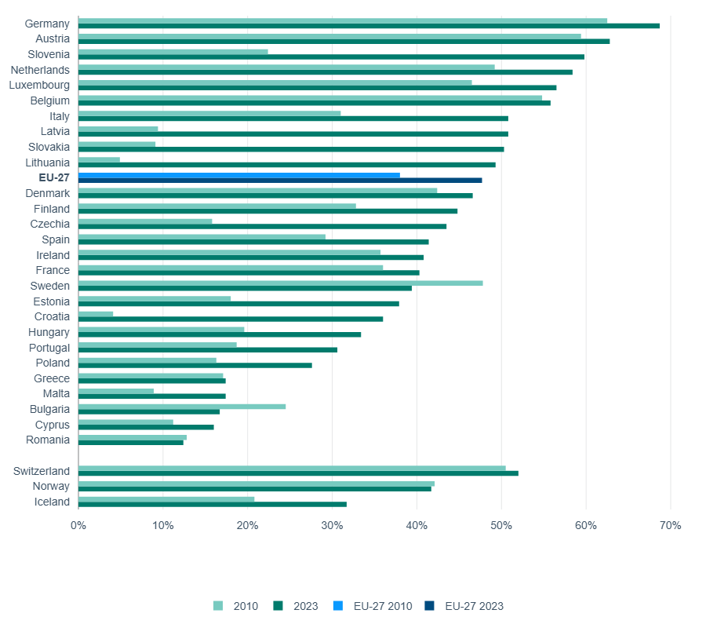
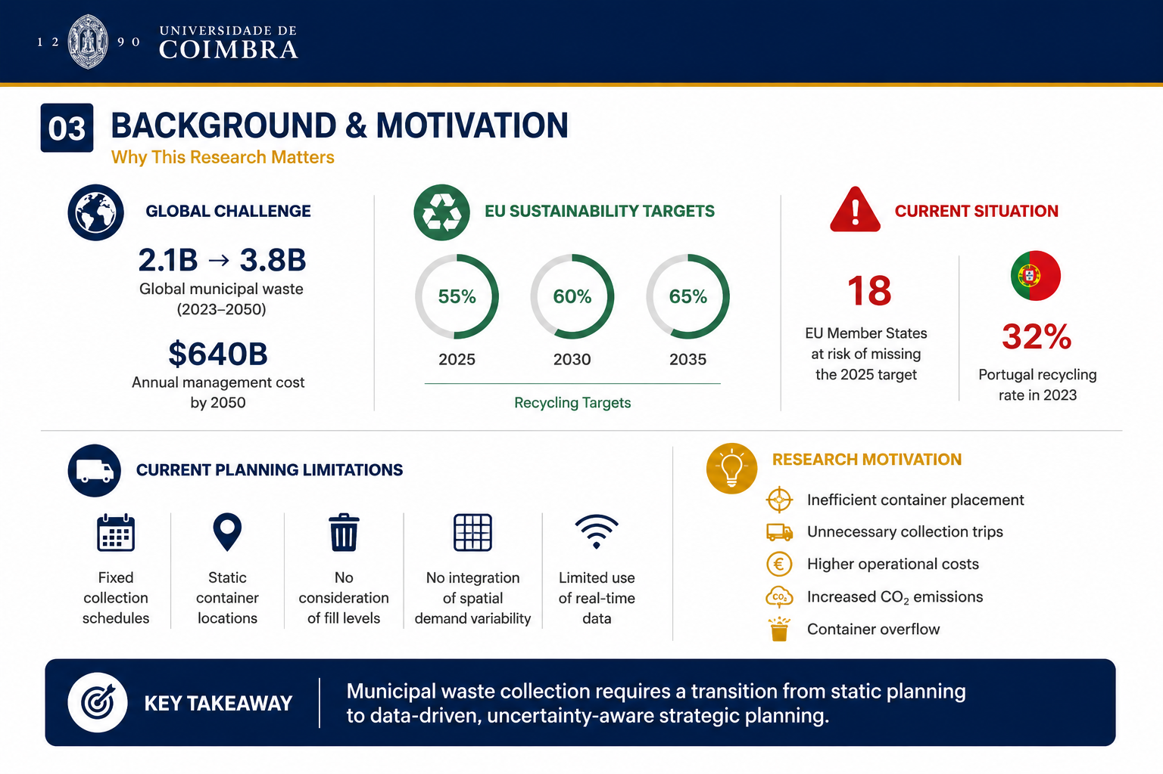
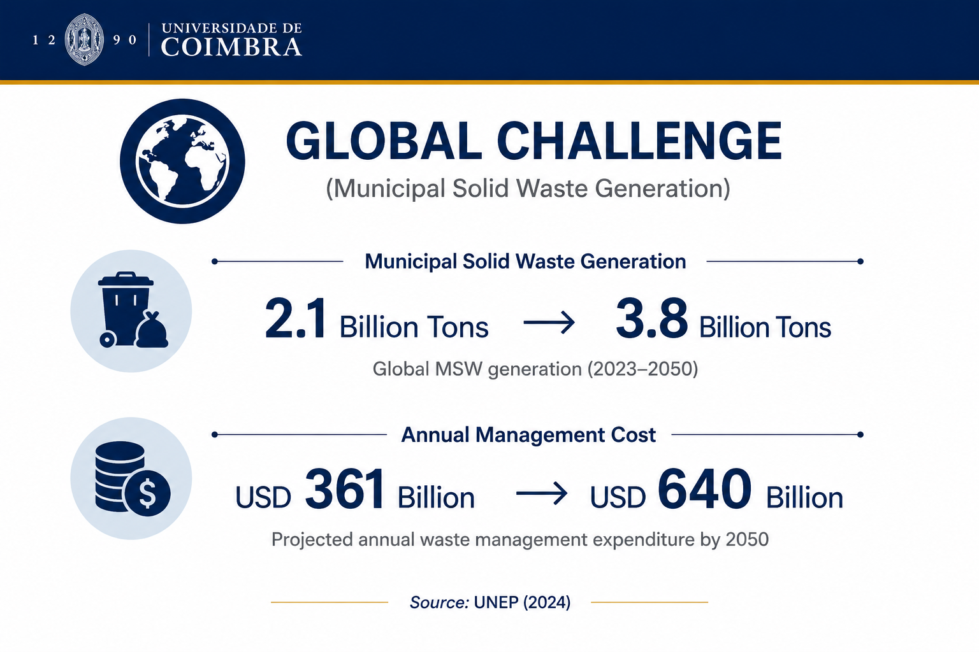
WHY IT MATTERS
2. Background & Rationale
Traditional planning (blind collection)
Fixed collection schedules
No demand estimation
ignores fill levels,
Fails to capture spatial and temporal demand variability.
Reality of waste generation
Dynamic and uncertain
Spatially and temporally variable
Requires data-driven demand estimation
Key Takeaway:
.
Static planning is insufficient. Data-driven demand estimation enables robust infrastructure planning.

Slide 5
3.RESEARCH GAP
From Reactive Waste Collection to Predictive Infrastructure Planning
Current Planning Limitations
The Core Research Gap
Fixed collection schedules
Deterministic demand assumption
Reactive ("blind") collection
Existing studies typically investigate waste demand modelling, facility location, and demand uncertainty as separate research problems. Few study integrate these components into a unified decision-support framework.
Research Streams Commonly Studied Separately
+
+
Waste Generation Modeling
Facility-location planning
Demand uncertainty
Proposed integrated framework
This research integrates three sequential components into a unified decision-support framework:
→
→
Stochastic Facility Location
Demand Estimation
Deterministic Facility Location
Key Takeaway:
This research proposes a sequential decision-support framework that integrates demand estimation with deterministic and stochastic facility-location models to support robust strategic municipal waste infrastructure planning under demand uncertainty

Slide 6

4. MAIN RESEARCH QUESTION
“How can waste generation modelling be integrated with deterministic and stochastic p-median facility location models to improve strategic municipal solid waste container planning under demand uncertainty?”
RESEARCH OBJECTIVES
01
02
03
04
System Characterisation
Waste Generation Modelling
Stochastic Facility Location
Deterministic Facility Location
Develop and validate statistical models for estimating municipal solid waste generation.
Develop a deterministic p-median model to identify baseline strategic container locations.
Extend the deterministic model to explicitly incorporate demand uncertainty.
Characterise the existing municipal solid waste collection system in Rio Maior and develop the spatial and operational database.
Overall Goal: Develop a robust and transferable framework for strategic municipal waste planning under demand uncertainty

Slide 7
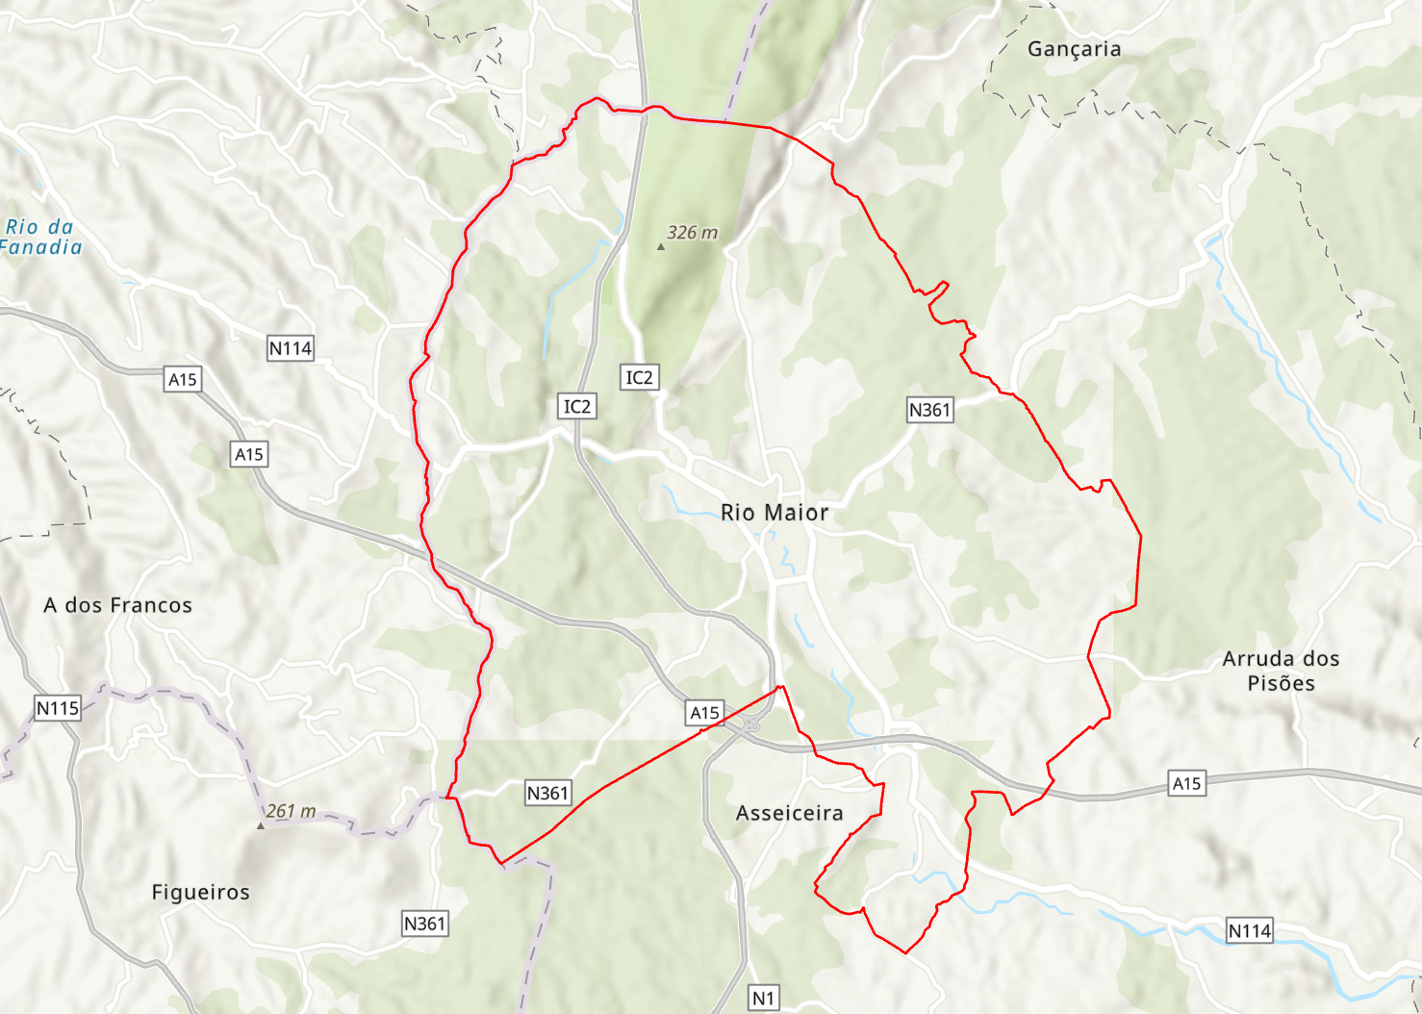
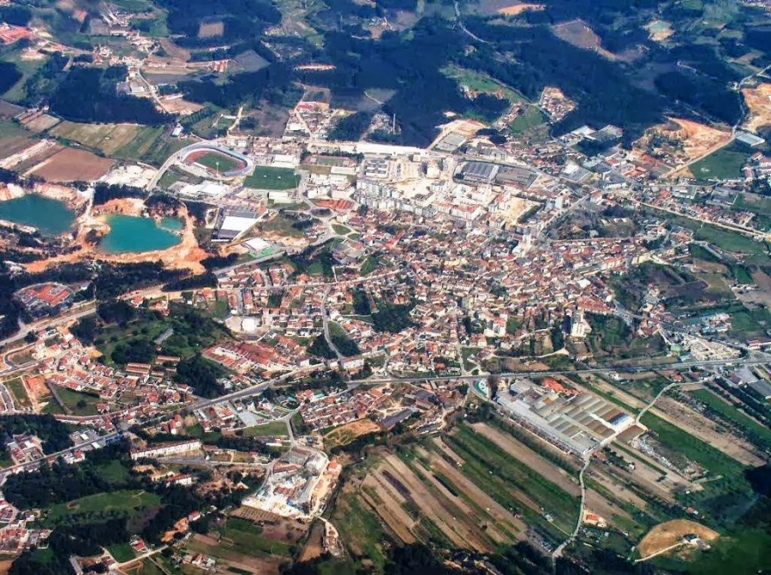
5. Case Study: Rio Maior, Portugal
Municipal Profile
Area: 272 km², Santarém District, Central Portugal
Population: 21,004 inhabitants (2021Census (
Recycling Infrastructure: different ecoponto container typologies
Company Valorsul responsible all management system
Operational database (2020–2024): GIS layers, sensor records, driver observations and collection data
Operational Challenges
Fixed collection schedules independent of actual fill levels ("blind collection")
Partial sensor coverage with hybrid monitoring (IoT + driver observations)
Seasonal variation from and summer activity
Limited financial and technical resources - representative of medium-sized EU municipalities
Key Takeaway:
These characteristic make Rio Maior a representative real-world case study for developing and validating data-driven methods for strategic municipal waste infrastructure planning.

Slide 8
6 · PROPOSED METHODOLOGY
A Sequential, Data-Driven Research Framework
1. System Characterisation & Database Development
2. Waste Generation Modelling
3. Deterministic Facility Location
4. Stochastic Facility Location
Input • Historical collection records • GIS layers • Demographic data • Land use data Output Container-level database
• Stepwise regression
Output Estimated waste generation
• Deterministic p-median • Determine optimal facility locations
Output Baseline facility location solution
• Demand uncertainty • Stochastic p-median
Output more Robust strategic facility-location decisions
Each stage provides the input for the next, creating an integrated decision-support framework for strategic municipal waste infrastructure planning.
KEY MESSAGE: From data to robust strategic infrastructure planning under demand uncertainty.

Slide 9
7.Operational Database
Data Sources
Historical Collection
records
GIS spatial data
Demographics information
Land-use
characteristics
Integrated analytical database
2020–2024 · Bin-event → Bin-day → Bin-level
Waste Generation Modelling
Regression Modeling Workflow
Model evaluation criteria:
R2 ,Adjusted R2
AIC-BIC
VIF(multicollinearity)
Residual diagnostics ( normality , Homoscedasticity)
Dependent variable:
Average daily waste per container
Candidate predictors:
Population · Distance to CBD · Land-use proportions
Initial Full OLS
R² = 0.013
low explanatory power
Model refinement required
Initial specification not adequate
Stepwise Multiple
Regression
Stepwise variable selection
Candidate Models
Strict / Borderline
/ Best-AIC
Selected candidate models

Slide 10
8.WASTE GENERATION MODELLING
From Full OLS to a Parsimonious Model
→
→
Alternative Candidate Models
→
Full OLS Model
Stepwise Regression
Final Selected Model
Systematic variable
selection procedure
Strict ·
Borderline
Best-AIC
All candidate explanatory variables
R² = 0.013
Strict Stepwise Model
(most parsimonious)
Compared using statistical and diagnostic criteria
Stepwise Multiple Regression Model
Regression Equation: log(1+Y) = 5.186 + 0.000477 × Population_Buffer + 0.000212 × Distance_to_CBD
Demand Equation: Y = exp(5.186 + 0.000477 × Population_Buffer + 0.000212 × Distance_to_CBD_m) - 1
R²
Maximum VIF
Breusch-Pagan p
0.074
1.081 (no multicollinearity)
0.323 (No evidence of heteroskedasticity )
objective of this model is demand estimation rather than behavioural prediction
Key Findings:
Population within the 100 m buffer was significant.
Distance to the CBD was significant.
Estimated demand for 452 containers.
Average estimated demand = 341.24 kg/day.

Slide 11
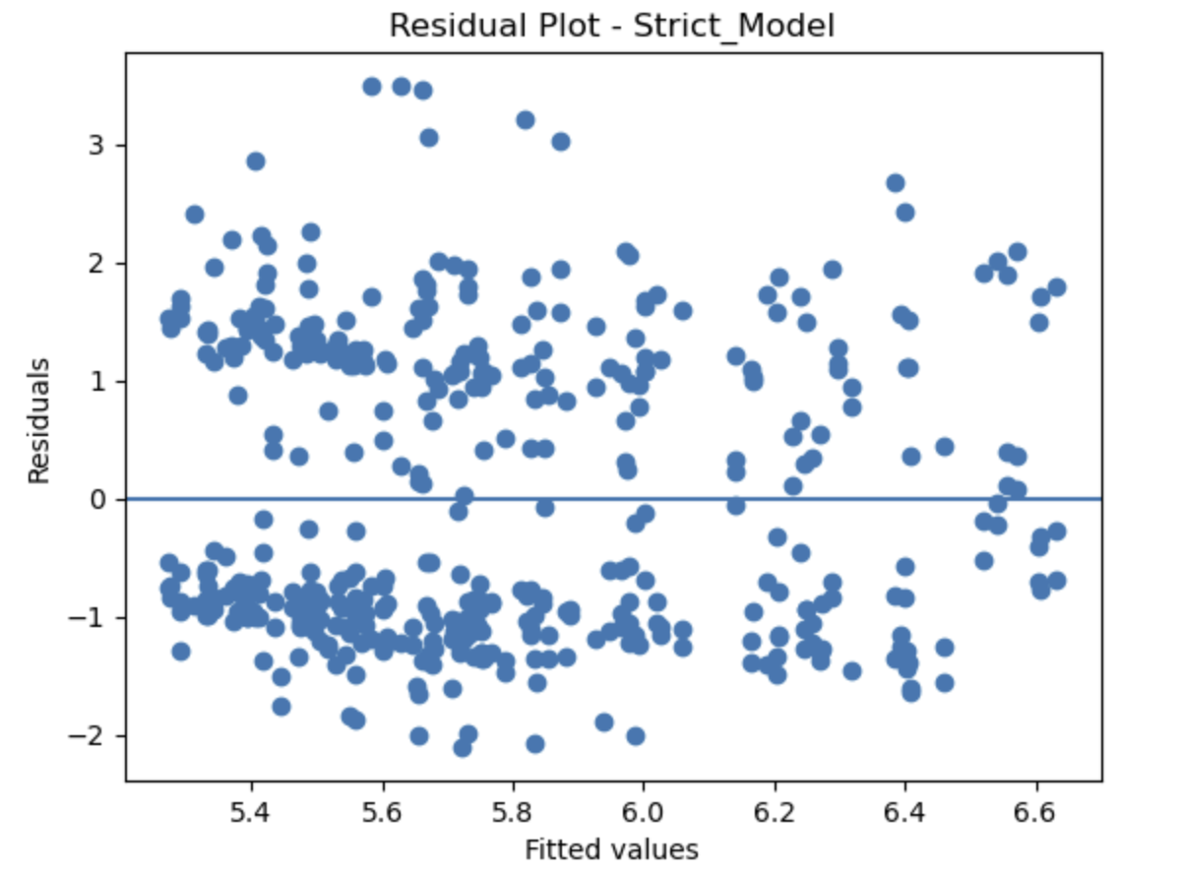
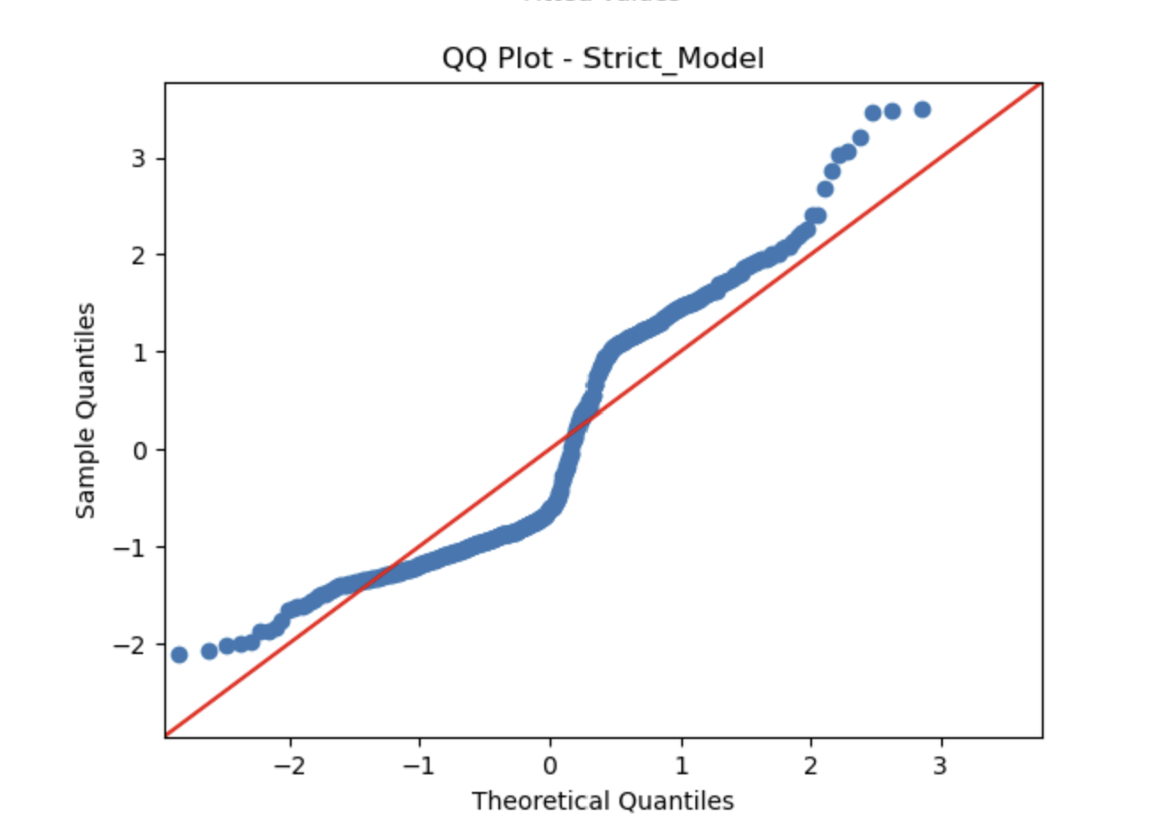
✓ Residuals are approximately normally distributed in the central region.
✓ Moderate deviations appear in the tails.
✓ Normality assumption is reasonably satisfied.
✓ Overall, the residual diagnostics support the adequacy of the regression model for estimate waste genaration
✓ Residuals randomly scattered around zero
✓ No systematic pattern detected
✓ Approximately constant variance
✓ Breusch–Pagantest : p = 0.323 (> 0.05)
Conclusion: Homoscedasticity assumption is satisfied.

Slide 12
9.Deterministic Facility Location Model
Mathematical Formulation
Test Scenario Results
Objective: Minimize total weighted distance
between demand points and selected sites
(facility location)
3 Facilities Selected
10
Sites 1, 6, and 7 from 8 candidates
population centers
(Demand Points)
min Σᵢ Σⱼ wᵢ dᵢⱼ Xᵢⱼ
Constraints: Exactly p facilities open; each demand point assigned once; binary decision variables.
2,770 Residents
106.6 m
Population covered
Average service distance
Key ASSUMPTION
Waste demand is fixed and known throughout the planning horizon
The deterministic model generated a feasible baseline facility-location solution under fixed demand assumptions.
This solution is integrated into the subsequent stochastic optimization model, where demand uncertainty is explicitly incorporated to support more robust strategic facility-location decisions.
Implementation
Software: FICO Xpress Optimizer, Mosel
Method: Dual simplex
OUTPUT
Baseline facility-location solution

Slide 13
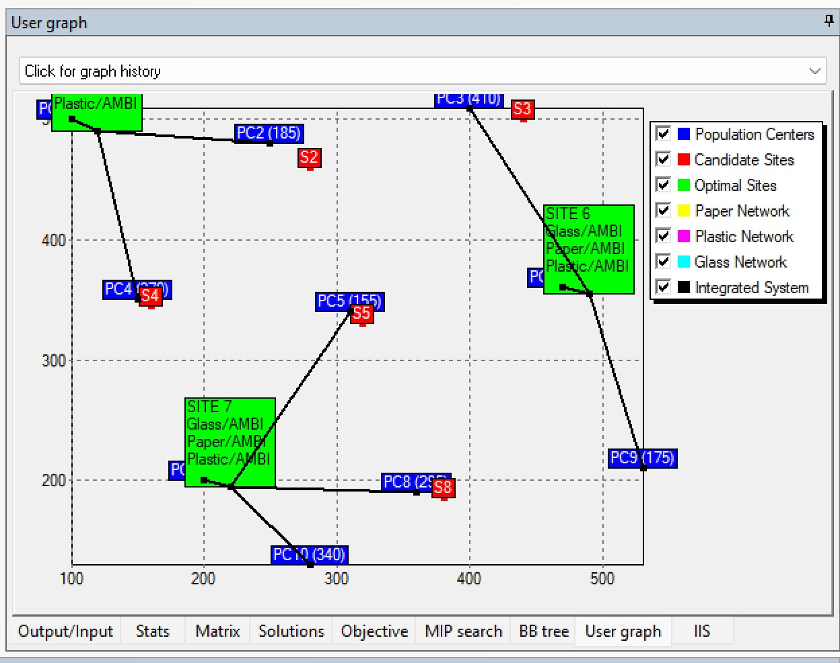
The solution minimises the total demand-weighted travel distance while ensuring full service coverage.
Deterministic Facility Location Results (FICO Xpress)
Three optimal ecoponto locations (Sites 1, 6, and 7) were selected.
All population centres are assigned to the nearest selected facility.
The solution minimizes the total demand-weighted travel distance while ensuring full service coverage.
This deterministic solution provides the baseline facility-location configuration for the subsequent stochastic optimisation model.
Assumption: fixed and known waste demand

Slide 14
10 · Why Stochastic Facility Location?
From Fixed Demand to Robust Strategic Planning
Current Approach
Real-World Challenge
Proposed Solution
DETERMINISTIC p-MEDIAN
• Fixed demand
• Single demand estimate
• Static assumptions
Baseline solution
REAL-WORLD CONDITIONS
• Seasonal variation
• Population dynamics
• Tourism
• Behavioural variability
Dynamic & uncertain demand
STOCHASTIC APPROACH
• Explicit uncertainty
• Robust optimisation
• More robust facility-location decisions
• More resilient infrastructure planning
More robust strategic planning
Fixed Demand
≠
Real Municipal waste Generation
KEY MESSAGE: Municipal waste demand is inherently uncertain. therefore, strategic facility-location decisions should explicitly account for uncertainty rather than relying solely on deterministic demand assumptions

Slide 15
11.CONCLUSION
Towards a Unified Framework for Municipal Solid Waste Infrastructure Planning
RESEARCH CONTRIBUTION
This research proposes a sequential, data-driven framework integrating waste demand modelling with deterministic and stochastic facility-location optimisation for strategic municipal recycling infrastructure planning under demand uncertainty.
STEP 1
Waste Demand Modelling
• Demand estimated using stepwise regression
• population with buffer area and CBD distance identified as most significant predictors
• demand estimates used as input for facility location
STEP 2
Deterministic Facility location
• Deterministic p-median developed.
• Generated a baseline facility –location configuration
Provides a reliable baseline strategic solution
Minimize total weighted distance
between demand points and selected sites under fixed demand
STEP 3
Stochastic Facility location
• Explicitly incorporates demand uncertainly (seasonality , population dynamics, behaviour, tourism). • proposes a stochastic optimization framework
objective is supports more robust facility -locations decision and supports more resilient infrastructure planning under real world condition
Overall contribution: integration of waste demand estimation, deterministic optimization, and stochastic optimization into a unified decision –support framework for strategic municipal infrastructure planning
Thank You for Your Attention

